Slide 1

PREDICTING THE HAPPENING OF A CRIME IN A REGION
Batch No:13
Guided By
G.Pratharan Sai Rupak Reddy

Slide 2

Slide Map
ABSTRACT
TERMINOLOGY USED
EXISTING SYSTEM
BLOCK DIAGRAM
PROPOSED SYSTEM
SYSTEM ARCHITECTURE
PROJECT DESCRIPTION
SYSTEM REQUIREMENTS
ADVANTAGES
IMPLEMENTATION
RESULTS
CONCLUSION
REFERENCES
www.techionary.info

Slide 3
Abstract
Crime analysis and prevention is a systematic approach for identifying and analyzing patterns and trends in crime. Our system can predict have high probability for crime occurrence in a region.Using the concept of Machine Learning we can extract previously unknown, useful information from an structured data. The main scope of the project is to predict the crime rate in a particular region based on the historic data and visualize it graphically using statistical tools so that , it is easy to look and understand the data to support public safety, financial success and better outcomes.With the advent of the Big Data era and the availability of fast, efficient algorithms for data analysis, understanding patterns in crime from data is an active and growing field of research. This project presents the visualization techniques and classification algorithms that can be used for predicting the crimes and helps the law agencies. So,we thought of building the machine learning model and with minimum accuracy of 85% and data visualizations so that, it could give accurate predictions.
In this project, we will be using the technique of machine learning for crime prediction of Los Angeles crime data set.These are the steps followed in Crime Analysis :Data collection, Data cleaning, Data handling, Predictive modeling ,Model selection, Prediction, Visualization, Conclusion.
In future, there is a plan for applying other classification algorithms on the crime data and improving the accuracy in prediction.
www.techionary.info

Slide 4
Terminology Used
MACHINE LEARNING
Python version-3.6
Data collection
Data cleaning
Data processing
Libraries-sklearn,numpy,pandas,scipy,math,tensorflow,seaborn,csv
Training
Linear Regression
Decision tree classifier
Data visualization
Model Deployment
www.techionary.info

Slide 5
Existing System
One company using big data and machine learning to try to predict when and where crime will take place is Predpol. They claim that by analyzing existing data on past crimes they can predict when and where new crimes are most likely to occur. Currently their system is being in several American cities including Los Angeles, which was an early adopter.
Their algorithm is based around the observation that certain crime types tend to cluster in time and space. By using historical data and observing where recent crimes took place they claim they can predict where future crimes will likely happen. For example a rash of burglaries in one area could correlated with more burglaries in surrounding areas in the near future. They call this technique real-time epidemic-type aftershock sequence crime forecasting. Their system highlights possible hotspots on a map the police should consider patrolling more heavily.
One success the company highlights is Tacoma, Washington, which saw a 22 percent drop in residential burglaries soon after adopting the system. Tacoma started using Predpol in 2013 and saw the drop in burglaries in 2015.
Given that crime is such a complex issue with numerous causes, it is very difficult to isolate the impact any one tool has. However, one study by researchers at Predpol concluded that police patrols based on near real-time epidemic-type aftershock sequence crime forecasting (what Predpol uses) results in a 7.4% reduction in crime volume.
www.techionary.info

Slide 6
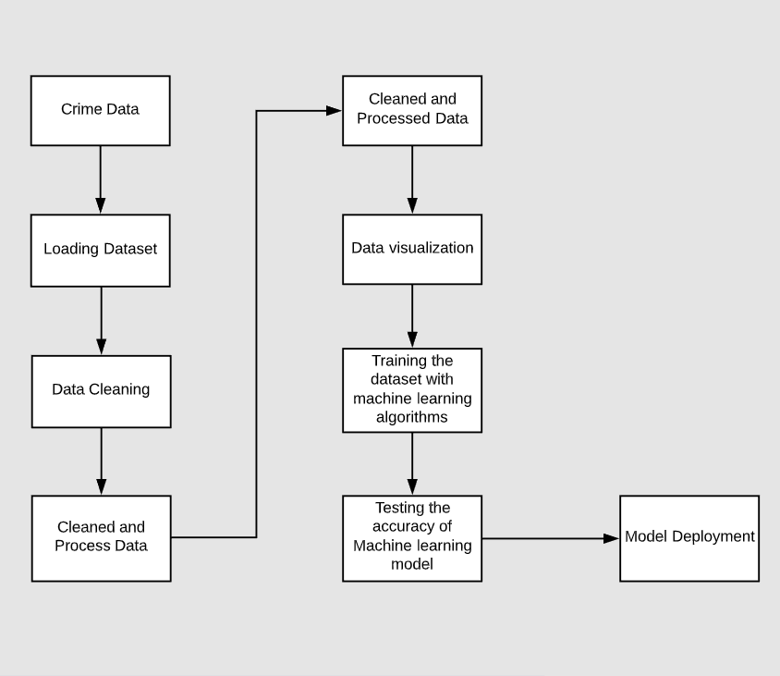
Block Diagram
www.techionary.info

Slide 7
Proposed System
In this project we have created a machine learning model that could predict the crime in a particular region.This model is created using decision tree classifier algorithm which could predict the crime with 91% of accuracy.This model can also be further used by adding any user interface.This model is deployed so this model can be used by anyone to predict the crime rate and test the accuracy of the model.
www.techionary.info

Slide 8
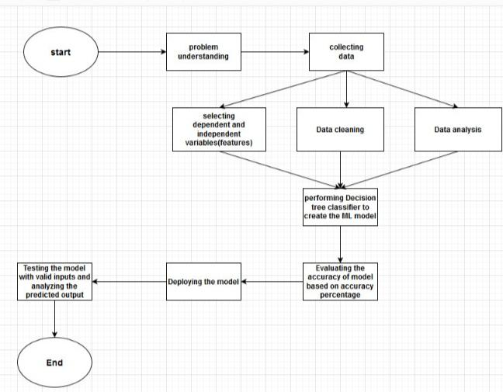
System Architecture
www.techionary.info

Slide 9
Project Description
Crimes now a days are increasing day by day and with different level of intensity and versatility. The result is great loss to society in terms of monitory loss, social loss and further it enhances the level of threat against the smooth livelihood in the society. To overcome this problem the computing era can help to reduce the crime or even may be helpful in predicting the crime so that sufficient measures can be taken to minimize the loss to property and life. The crime rate prediction strategies can be applied on historical data available in the police records by examining the data at various angles like reason of crime, frequency of similar kind of crimes at specific location with other parameters to prepare the machine learning model for crime prediction. It is the major challenge to understand the versatile data available with us then model it to predict the crime incidence with acceptable accuracy and further to reduce the crime rate.
www.techionary.info

Slide 10
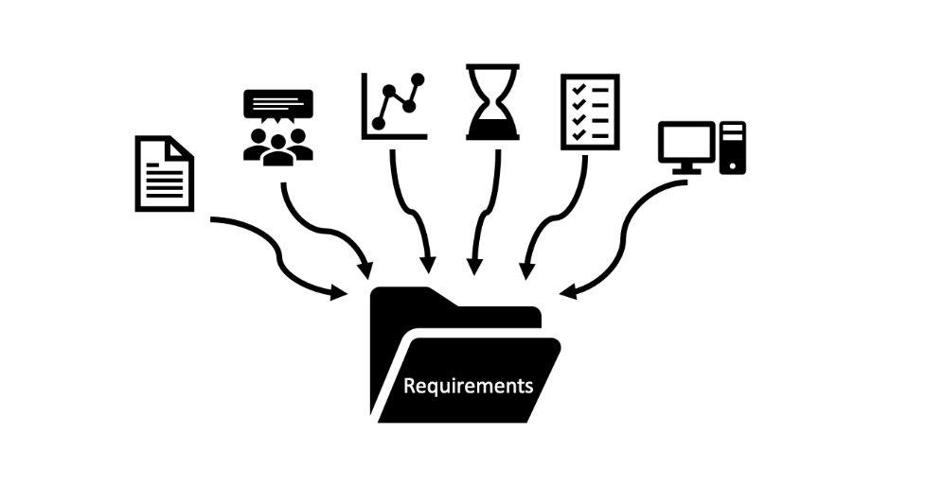
System Requirements
A desktop/laptop, programming knowledge with python and familiarity with machine learning concepts and data visualizations. In this project we used python-version 3.6 and the platform used is google collaboration. Google Colab allows to write and run python code interactively the same way as Jupyter Notebook does.
www.techionary.info

Slide 11
Advantages
The greatest advantage with crime prediction technology is that law enforcement agencies will be able to make prompt responses and within a short response time. Consistency in record keeping, analyzing what type of force is needed, the number of encounters and fatalities can be collected using crime prediction.Nowadays police has been using an innovative analytical practice to check the occurrence of crime and crack the crimes of past. This analytical practice mostly involves quantitative techniques to spot out probable criminal for police intervention. This practice is being applied by various LEAs (Law Enforcement Agencies) across the world and is commonly referred to as Predictive Policing. It is exceptionally effective and has been thoroughly acknowledged also. On many occasions it is described as forecasting even. The predictive technology is utilized to support different operations of police and some of the methods are quite potential.. Early warning systems and constant vigilance through police patrolling can be employed in hot spots of crime. This will ensure a better sense of safety within communities.
www.techionary.info

Slide 12
Implementation
STEP 1: Collected dataset from kaggle and explored the dataset as per requirement. In this dataset 1994 areas are present. Size of the dataset is 1994 rows and 128 columns. The dataset features are: the occurrence month, the occurrence day of the week, the occurrence time and the crime location,etc.
STEP 2: Imported the required modules into the jupyter notebook and implemented data cleaning, analysing correlation(relationship between variables using heatmap)on the data set are done.
STEP 3: After that, we had used machine learning algorithms like regression and decision tree classifier to train the dataset and build machine learning model to get good accuracy.
STEP 4: The accuracy rate is 85% with Decision tree classifier and 0.65 R2 score with Linear Regression. To increase the previous accuracy rate tensor-flow GPU is used and Decision tree classifier algorithm is optimized.
STEP 5: After following above standards the accuracy increased to 91%. So,the model predicts the crime of a taken region with accuracy of 91%.
www.techionary.info

Slide 13
Results
Our project aim is to predict the crime rate of a particular region.So, we thought of building the machine learning model and with minimum accuracy of 85% and data visualizations so that, it could give accurate predictions.
Implementing data cleaning, analysing correlation the accuracy rate is reached to 85% with Decision tree classifier and 0.65 R2 score with Linear Regression.To increase the previous accuracy rate tensor-flow GPU is used and Decision tree classifier algorithm is optimized. This made performance high in our project i.e.,91% accuracy.
www.techionary.info

Slide 14
Conclusion
With the help of machine learning technology, it has become easy to find out relation and patterns among various data’s. The work in this project mainly revolves around predicting the crime of region where it has occurred. Using the concept of machine learning we have built a model using data set that have undergone data cleaning. The model predicts the crime of a particular area with accuracy of 91%. Data visualization helps in analysis of data set and output accuracy.
www.techionary.info

Slide 15
References
1. Yadav, S., Timbadia, M., Yadav, A., Vishwakarma, R., & Yadav, N. (2017, April).Crime pattern detection, analysis & prediction. In Electronics,Communication and Aerospace Technology (ICECA), 2017 International conference of (Vol. 1, pp. 225- 230). IEEE.
2. Shamsuddin, N. H. M., Ali, N. A., & Alwee, R. (2017, May). An overview on crime prediction methods. In Student Project Conference (ICT-ISPC), 2017 6th ICT International (pp. 1-5) . IEEE.
3. Sivaranjani, S., Sivakumari, S., & Aasha, M. (2016, October). Crime prediction and forecasting in Tamilnadu using clustering approaches. In Emerging Technological Trends (ICETT) International Conference on (pp. 1-6). IEEE.
4. Sathyadevan, S., & Gangadharan, S. (2014, August). Crime analysis and prediction using data mining. In Networks & Soft Computing (ICNSC), 2014 First International Conference on (pp. 406-412). IEEE.
5. Nath, S. V. (2006, December). Crime pattern detection using data mining. In Web intelligence and intelligent agent technology workshops, 2006. wi-iat 2006 workshops. 2006 ieee/wic/acm international conference on (pp. 41-44). IEEE.
6. Zhao, X., & Tang, J. (2017, November). Exploring Transfer Learning for Crime Prediction. In Data Mining Workshops (ICDMW), 2017 IEEE International Conference on (pp. 1158-1159). IEEE.
www.techionary.info

